Slide 1



The City of New Braunfels Parks and Recreations Asset Management Project

Slide 2

GIS Consultants
  Project Manager/GIS Analyst: Kevin Sardino
  Asst. Manager/GIS Analyst/Web Master: Nathan Andrews
  GIS Technician/Data Specialist: Jenkins Barkley
  GIS Analyst/Technical Writer: Mukarram Kamran

Slide 3
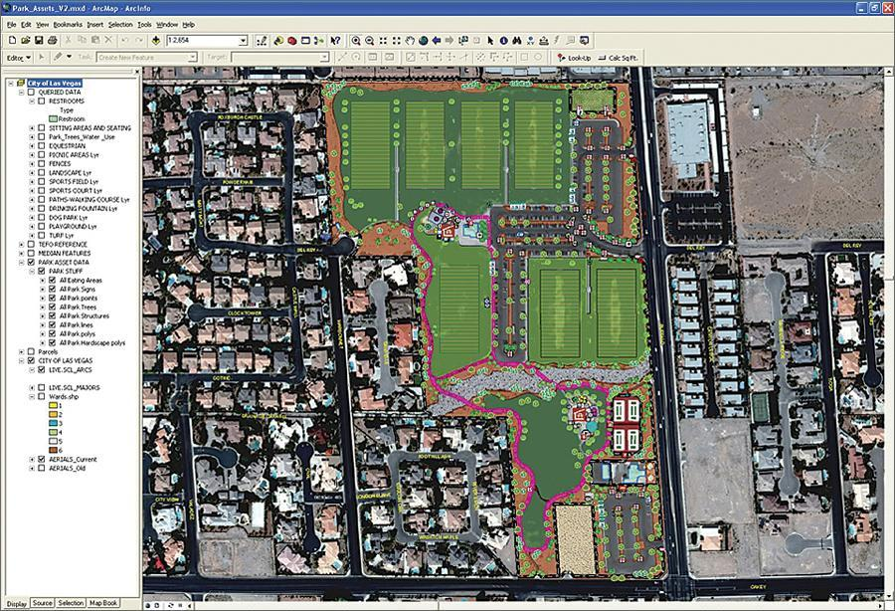
Summary
Over the past few years GIS has become an ever important tool to help Municipal Governments manage their cities.
An excellent example is Las Vegas's Department of Operations and Maintenance and how they developed ParkPad to be used mobile with Arcpad software and GIS.
Image 1: (http://www.esri.com/news/arcnews/spring12articles/spring12gifs/p16p1-lg.jpg)

Slide 4
Summary
Integrating GIS into any cities existing management systems like Accela would be advantageous.
It will also result in the City being able to better manage their assets and infrastructure
predict maintenance costs months in advance
track/place work orders
track employee’s time
inventorying and many other cost and time saving applications/solutions for their parks

Slide 5
Purpose
Working with the City of New Braunfels GIS department to create an asset GIS schema or database for the City’s Parks and Recreations Department
The database will then be integrated into the existing Accela asset management system.

Slide 6
Purpose… cont.
  Set up meetings with employees of the Parks and Recreations Department
  Design a GIS schema or database around the assets of the park
  Conduct light field work with GPS units as well as moderate digitizing
  Finally, the team will help the CoNB GIS Analyst William Flynn synchronize the GIS schema/database with the Accela management system linking in all of the Parks and Recreations assets collected.

Slide 7
Scope
Large scale geographic extent of New Braunfels Park System and the assets that they have.
With data gathering focusing on assets from the parks recommended by the CoNB’s GIS Analyst William Flynn or from the Parks and Rec’s Dept as being top priority.

Slide 8
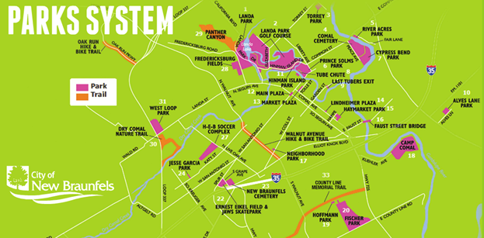
Scope cont.…
(Image1: http://www.newbraunfelsfunthingsinlife.com)

Slide 9
Data
Interviews with Parks and Recreation Department
Shape files
Building assets
Parks and Recreation boundary layer
  Available through City of New Braunfels GeoServer
Field work with Trimble GPS units
Digitizing

Slide 10
Methodology
1. Formulation of a needs assessment
Interview parks department staff
2. Pre-processing available data
Select data relevant to the parks department
Verify the accuracy
Process data for integration with Accela
3. Database Construction
Structure database to work seamlessly with spatial and aspatial data stored within it
4. Database Collection
Collect data for every category feature data that will need to be stored within the database

Slide 11
Implications
Efficient maintenance of park’s assets
Predict maintenance costs
Track/place work orders
Automated workflows
 Track employee’s time and activities
 Monitor inventory
Accurate real time tracking of data
Create a system that can easily be used by future data collectors.

Slide 12
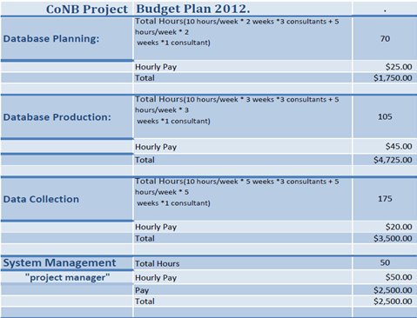
Budget
Budget continues…

Slide 13
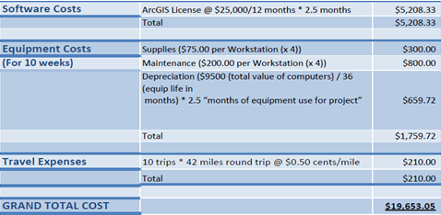
Budget

Slide 14
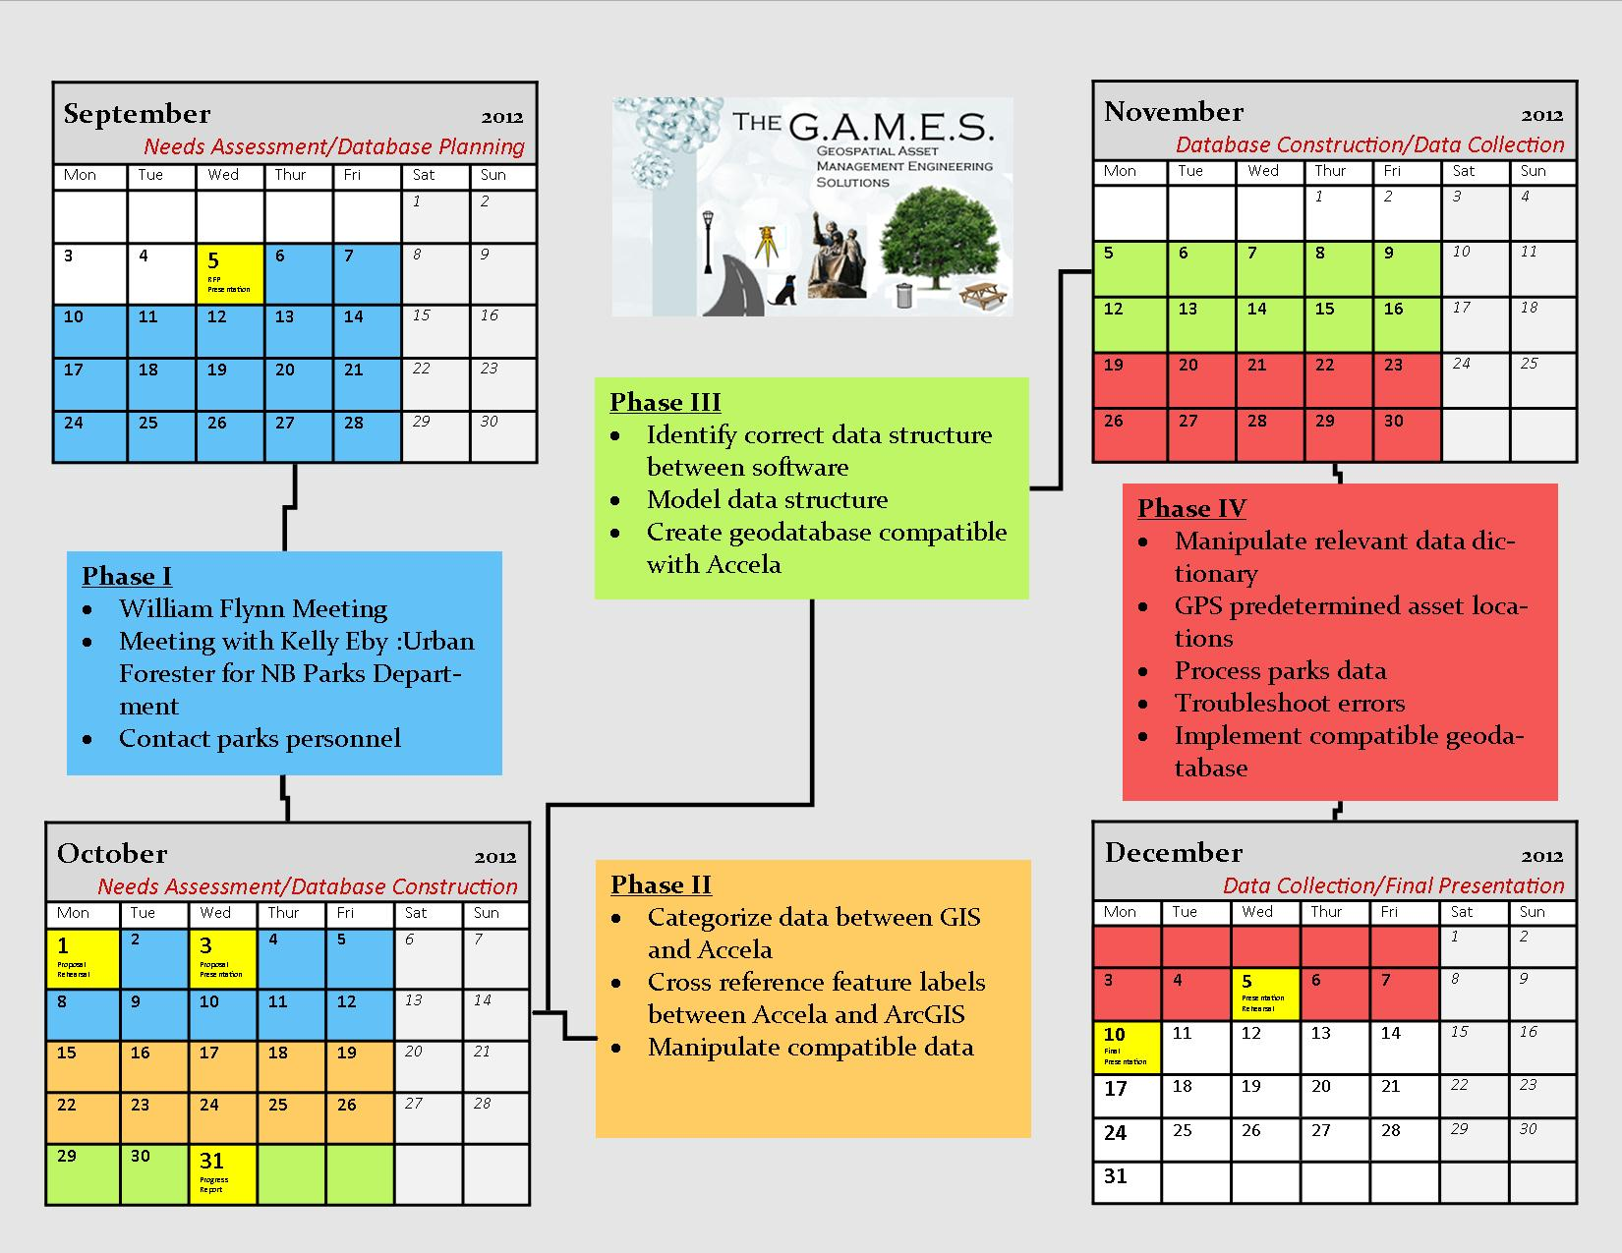
Time Table

Slide 15
Conclusion
The project will help design and create an effective asset management system for the Parks Department of the city New Braunfels.
The data will be based off a GIS geodatabase that will with Accela software.
The project will cover 40+ parks of New Braunfels
The project will cost upwards of $20,000 in a 3 month time period

Slide 16
Final Deliverables
We will deliver to you upon completion of the Project a:
Detailed Final Report (2 Copies)
Professional Poster for display in the Geography Department
CD (2 Copies) containing:
o All Data
o Metadata
o Report
o Poster
o PowerPoint Presentation
o Instructions on how to use the CD
§ Readme file
§ Link to our website
Note that testing will be conducted to ensure no corruption will occur and that all data is usable.

Slide 17
References
City of New Braunfels, Request For Proposal, City of New Braunfels, Texas, August 2012.
Dan Saltzman. Portlandonline.com. Total Asset Management, July 2006. Web. September 20, 2012. http://www.portlandonline.com/parks/index.cfm?a=151131&c=38306
Image 1: http://www.esri.com/news/arcnews/spring12articles/spring12gifs/p16p1-lg.jpg
Image 2 : http://www.newbraunfelsfunthingsinlife.com/
Joel Hillhouse. ESRI.com. ArcNews, Spring 2012. Web. September 29, 2012. http://www.esri.com/news/arcnews/spring12articles/city-of-las-vegas-implements-parkpad-for-mobile-asset-management.html
Lemer, A. (1998). Progress Toward Intergrated Infrastructure Asset Management Systems: GIS and Beyond. APWA International Public Works Congress, 1-18.

Slide 18
Questions? Or comments?

